Slide 1
AIML CA1 Part B
By Davian

Slide 2
Overview Of The Workflow
Data Preprocessing
Tuning Hyperparameters Of Models
Model Validation
Conclusion
Evaluating Chosen Model
Model Selection

Slide 3
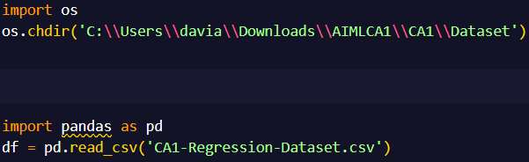
Importing Data
Using the Pandas module to import the regression dataset

Slide 4
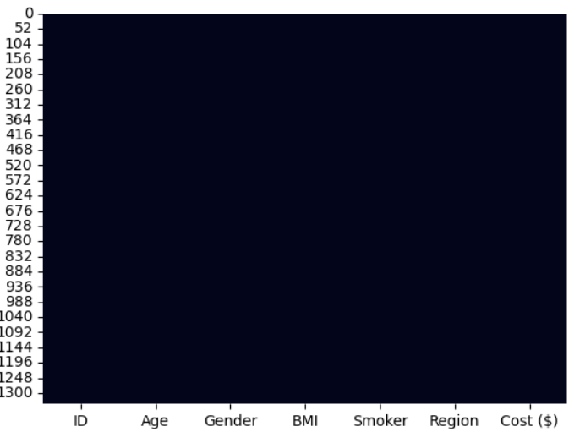
Preparing the Data
There is no missing data in the dataset and therefore there is no need to impute any data

Slide 5
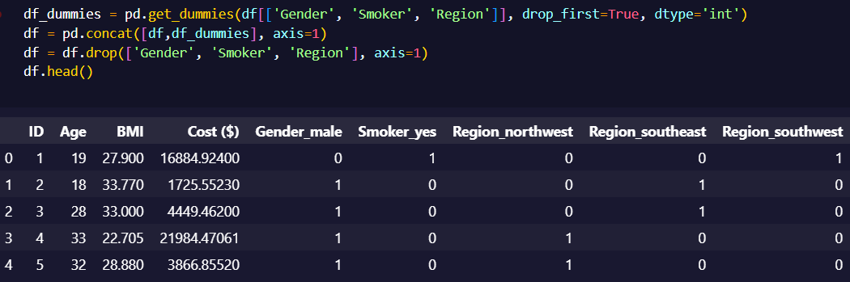
One Hot Encoding
There are a few columns that need to be converted into dummy variables like Gender, Smoker, and Region.
I converted it into dummy variables using the pandas get_dummies function.

Slide 6
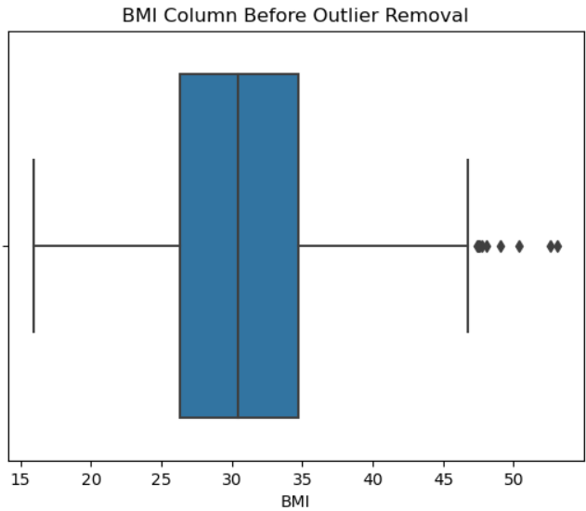
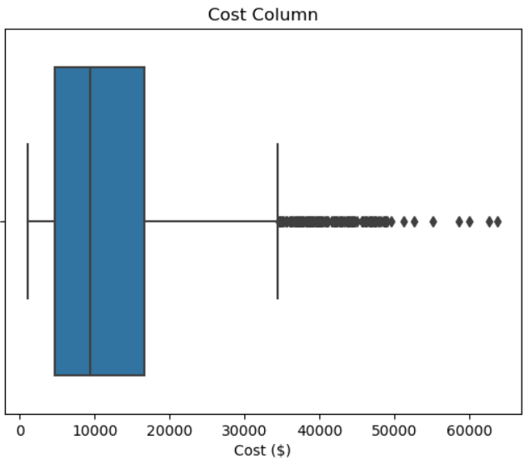
Dealing With Outliers
There are multiple outliers in the dataset.
However, as I cannot be 100% certain that the outliers are unreasonable, I have decided against removing the outliers.

Slide 7
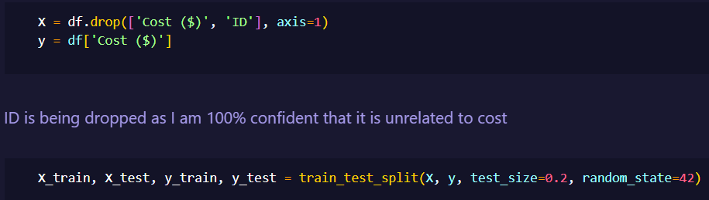
Train Test Split
The next step is to do train test split.
The ID column is being dropped as I am 100% confident that it is unrelated to cost

Slide 8
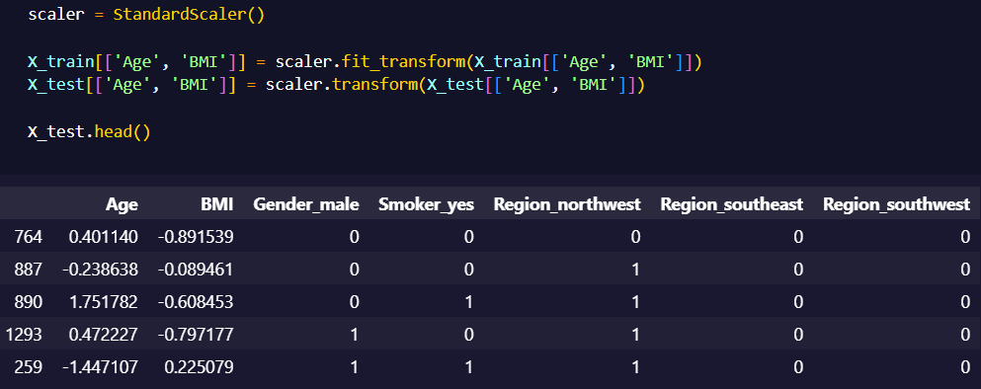
Data Scaling
I have scaled the Age and BMI column as scaling can help to balance the impact of all variables on the distance calculation and can help to improve the performance of the algorithm.

Slide 9
The 2 Approaches
I will be using 2 approaches to this. The first approach will be to use lasso to tell us which features are important while the second approach is me choosing which features are important.
I will then train the models on both sets of data and cross validate them and choose the best set of data

Slide 10
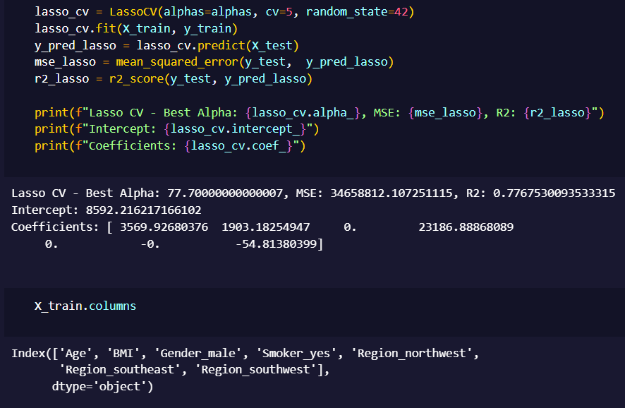
Feature Selection
I will use Lasso Regression to do the feature selection.
As you can see from the results, lasso regression considers the Age, BMI and Smoking Status as best indicators of Cost

Slide 11
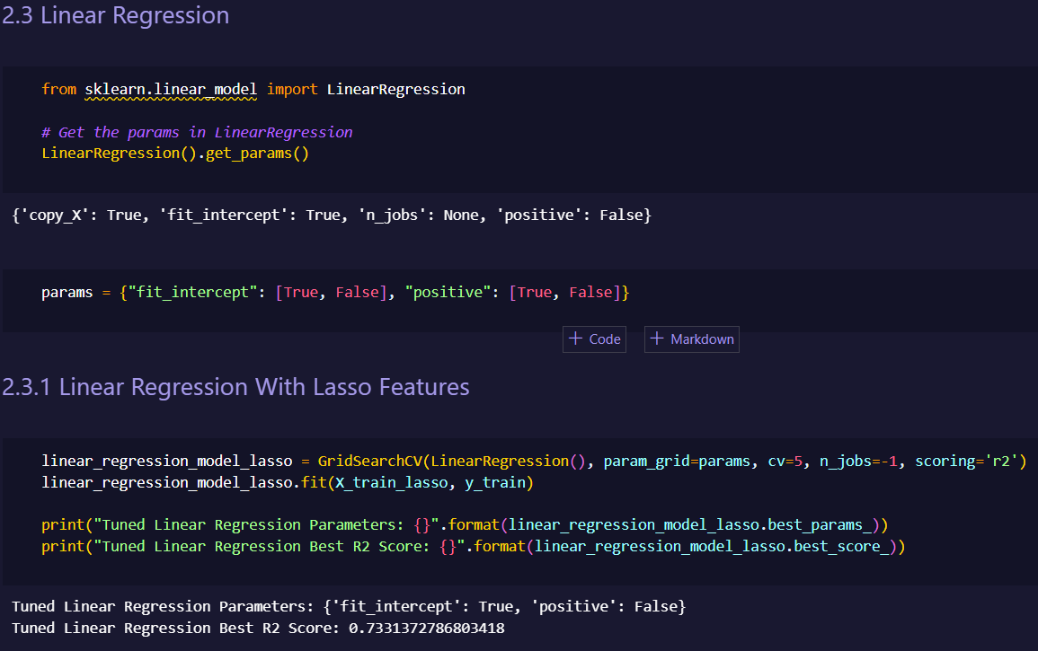
Tuning Hyperparameters Of Models
Now, we are in the process of tuning the hyperparameters of the chosen models.
I will tune the hyperparameters of each model 2 times, one for each dataset variant.
I have set scoring to R2.

Slide 12
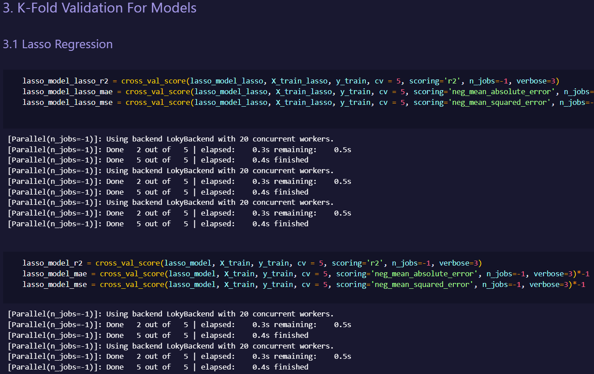
Model Validation
Now that the models hyperparameters are tuned, I will now do k fold validation on those model so that I can compare all model’s r2, MAE and MSE scores.

Slide 13
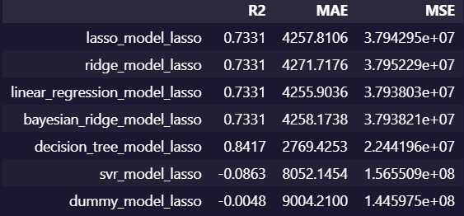
Model Selection
Now that I have gotten the scores on how each model perform on each of the dataset variant, I will now choose the model which has at least 2 of the best scoring metric.
From the results shown above, the Decision Tree Regressor trained on the features chosen by LassoCV and scaled has the highest R2 score, lowest MAE and MSE score making it clear that it is the best model for this dataset.

Slide 14
Model Selection
The decision tree regressor compares dramatically better to the dummy baseline. To be specific, its r2 score is 17635.4% higher than the baseline, its MAE is 69.24% better than the baseline and its MSE is 84.48% better than the baseline.

Slide 15
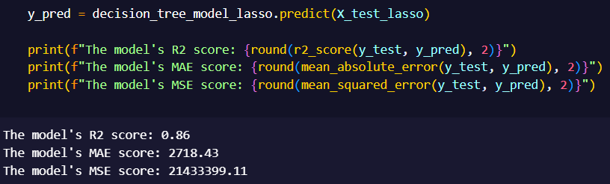
Evaluating The Chosen Model
Now I will test the model by making it predict on the x test and evaluating its results

Slide 16
Conclusion
In conclusion, we created 2 variants of the dataset, tuned the hyperparameters of all our models according to each of the 2 dataset and then did k-fold validation on each of the tuned models and chose the best model of them all after which, tested it on the test data.
The best model for this dataset is the Decision Tree Regressor trained on the features lasso chosen which are Age, BMI and Smoking Status of the patient.

